Slide 1
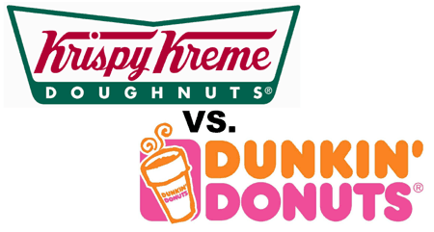
Krispy Kreme vs. Dunkin Doughnuts
By: Joe Brody

Slide 2
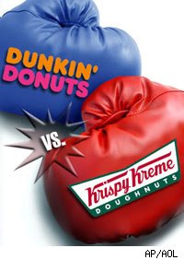
The Competition
Krispy Kreme and Dunkin Doughnuts have always been in endless competition. They have always been competing to claim the title of the best doughnut.

Slide 3
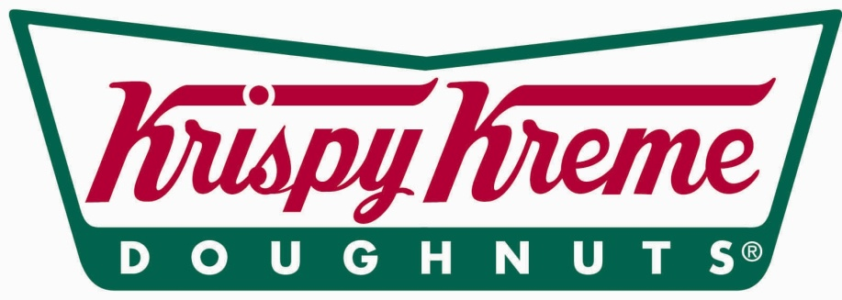
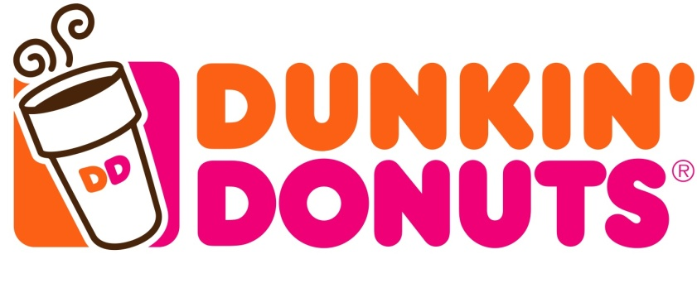
What I Think
As many of you know I like doughnuts. I like a doughnut whether it is from Krispy Kreme, Dunkin Doughnut, or the guy sitting on the highway.
But, when I have the choice I choose Krispy Kreme.

Slide 4
What “Attractions” Do they Have?
Krispy Kreme
Dunkin Doughnuts
They give “hats”
Some locations let you watch doughnuts being made
More of a Variety of Foods

Slide 5
What is Liked More?
Krispy Kreme
Both
Dunkin Doughnuts
12
3
25%
15%
60%
*Poll Taken By 20 People

Slide 6
Pro’s and Con’s
Krispy Kreme
Dunkin Doughnuts
Pros:
Served hot,
Always Glazed,
Less Calories
Cons:
$0.22 more,
Doesn’t serve many other kinds of food
Pros:
Little bit cheaper,
Serves more kinds of foods besides doughnuts
Cons:
70 more calories,
Don’t tell you when they are hot

Slide 7
The End!

